Slide 1
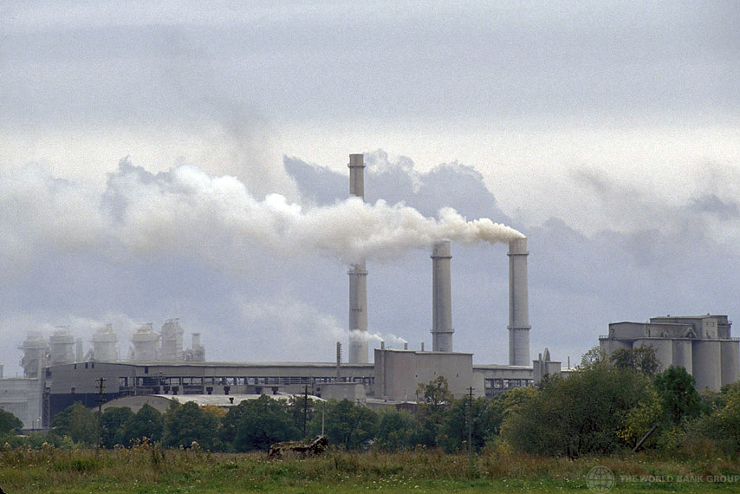
Moral Leadership and the Environment: A Discussion
Factory smokestacks CREDIT: World Bank (CC)
Carnegie Council for Ethics in International Affairs (2018)

Slide 2
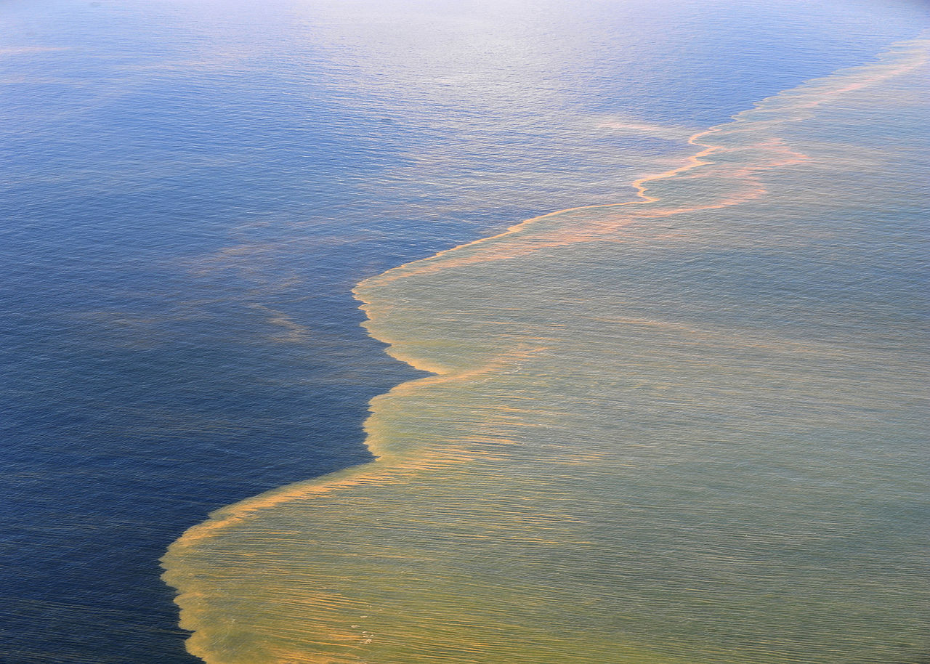
Is environmental protection a moral/social justice issue?
What are some ways in which the environment can affect our health and our lives?
Can you think of any stories in the news about environmental protection, good or bad?
Oil from the Deepwater Horizon oil spill approaches the coast of Mobile, Alabama, 2010. CREDIT: U.S. Navy (CC)
Carnegie Council for Ethics in International Affairs (2018)

Slide 3
Environmental Protection as a Moral/Social Justice Issue in the U.S.
Water Contamination: Some people do not have access to clean drinking water
Air Pollution: Residents in certain areas of the country are more likely to suffer from respiratory illnesses due to lack of regulation
Climate Change: Extreme heat has caused events such as forest fires, droughts, and storms to intensify
Carnegie Council for Ethics in International Affairs (2018)

Slide 4
Water Contamination:
Flint Water Crisis
The city of Flint switched to the Flint River as a water source in 2014
Tests from the EPA and Virginia Tech University showed dangerous levels of lead in homes
Lead consumption can negatively affect children (cognitive abilities and attention-related behaviors) and adults (lower kidney functions and higher blood pressure) among other ailments [NIH]
Carnegie Council for Ethics in International Affairs (2018)
Notes:
For more information about lead consumption and health: https://www.niehs.nih.gov/health/materials/lead_and_your_health_508.pdf

Slide 5

Activity 1: What was the response to the Flint Water Crisis?
Watch the CBS Sunday Morning clip
What was the situation?
Who responded?
How did the government work properly? How did it fail?
Dr. Mona Hanna-Attisha led the Hurley Medical Center lead poisoning study.
CREDIT: HappyPenguinista (CC)
Carnegie Council for Ethics in International Affairs (2018)
Notes:
https://www.cbsnews.com/news/the-flint-water-crisis-a-loss-of-trust/

Slide 6
Activity 2: How to respond to the
Flint Water Crisis
Read through the op-ed written by Dr. Mona Hanna-Attisha
What is the government doing as a response to the Flint Water Crisis?
What does she suggest needs to be done in addition?
Do you think Hanna-Attisha’s leadership on the issue has been successful? What can she achieve through an op-ed piece?
Carnegie Council for Ethics in International Affairs (2018)
Notes:
Op-Ed: https://www.nytimes.com/2016/03/27/opinion/sunday/the-future-for-flints-children.html?_r=1

Slide 7
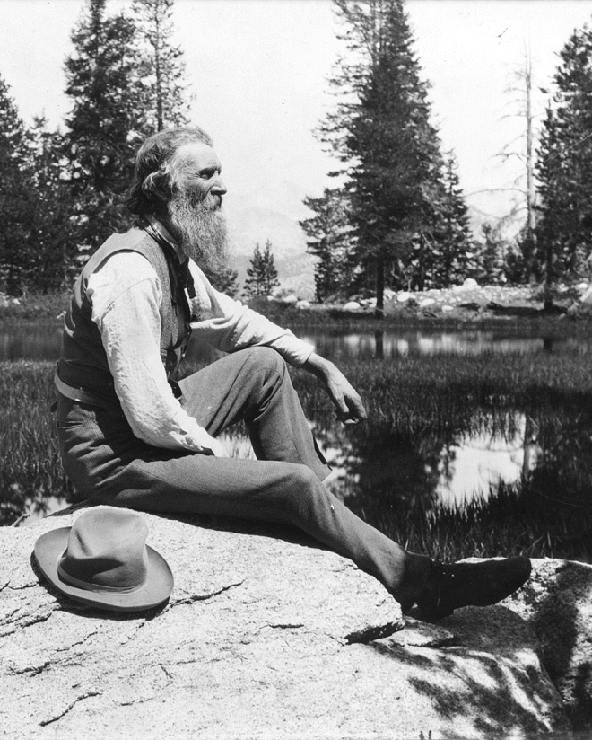
Moral Leadership and the Environment
What makes somebody a “moral leader” in regards to the environment?
What/who are they fighting for?
Do their ideas always have to be popular at the time?
John Muir helped preserve American wilderness and founded the Sierra Club.
CREDIT: Library of Congress (CC)
Carnegie Council for Ethics in International Affairs (2018)

Slide 8
Moral Leadership, the Environment, and your community
How can you show “moral leadership” concerning the environment and your community?
Do environmentally friendly acts need to be done on a large scale to make a difference?
How is “America’s Pledge” using local initiatives to make a big impact?
Carnegie Council for Ethics in International Affairs (2018)
Notes:
America’s Pledge video: https://www.americaspledgeonclimate.com/

