Slide 1
Defining Democracy:
An introduction to various forms of representative electoral systems
*These definitions should be seen as fluid and can vary depending on the government
Carnegie Council for Ethics in International Affairs (2018)
Notes:
Carnegie Council for Ethics in International Affairs (2018)

Slide 2
What is democracy?
What three key words/terms would you use to describe democracy?
  Why did you choose these terms?
Do you think all democracies, despite the country/location, work the same way? Why or why not?
Carnegie Council for Ethics in International Affairs (2018)

Slide 3
Democracy is a political system in which power is vested in and exercised by its citizens. This can take on many forms.
Direct democracies are when citizens vote directly on laws (plebiscites, referenda, or initiatives).
Indirect democracies are more common and have citizens who elect representatives, who then make laws that are supposed to be in the citizens’ best interests.
Carnegie Council for Ethics in International Affairs (2018)

Slide 4
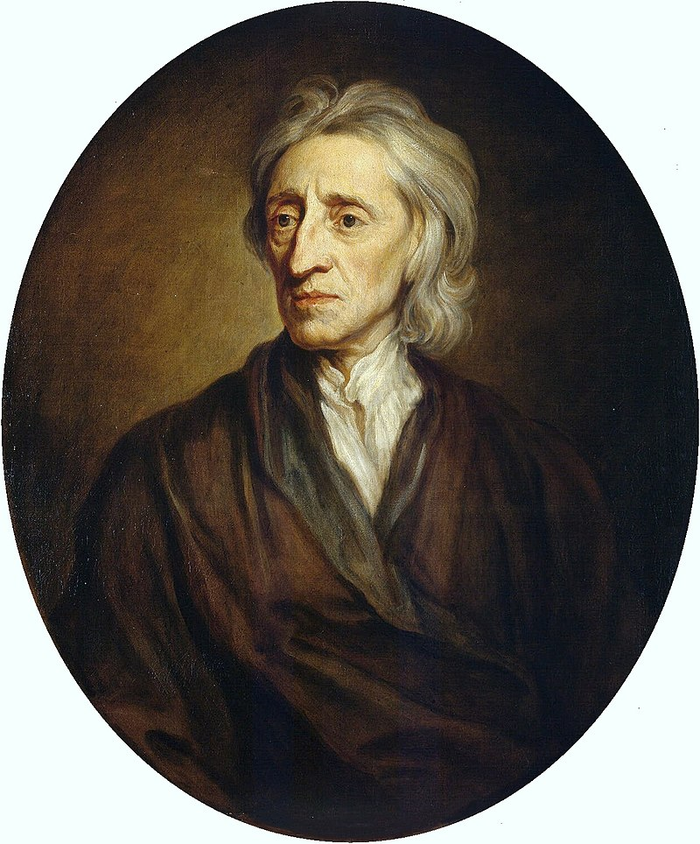
What is a liberal democracy?
Complete Activity 1 to define liberal democracy
What makes something “liberal”?
What countries would you consider to be liberal democracies?
John Locke’s philosophies helped create modern-day liberal thought
Photo Credit: Hermitage Museum (CC)
Carnegie Council for Ethics in International Affairs (2018)
Notes:
Activity 1: https://www.carnegiecouncil.org/education/worksheets/Ideologies/what-is-liberal-democracy

Slide 5
Liberal Democracy
A representative government with
  free and fair elections
  majority rule and minority rights (pluralism)
  an emphasis on separation of powers, constitutionalism, and rule of law,
  and the protection of individual liberties.
An example of a liberal democracy is the United States
Carnegie Council for Ethics in International Affairs (2018)

Slide 6
Social Democracy
Has all the political characteristics of a liberal democracy
There is a mixed (free market/socialist) economy that provides a social safety net for its citizens (public health care, education, etc.)
The main difference is that in a liberal democracy, it is more up to the individual to provide for themselves, whereas a social democracy provides more public welfare benefits.
Carnegie Council for Ethics in International Affairs (2018)

Slide 7
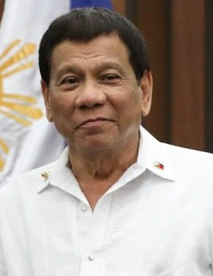
Illiberal Democracy
If we have an understanding of liberal democracy, how can we define illiberal democracy?
Complete Activity 2 to learn more about illiberal democracies
Philippine President Rodrigo Duterte
Photo Credit: Presidential Communications Operations Office , Philippines (CC)
Carnegie Council for Ethics in International Affairs (2018)
Notes:
Activity 2: https://www.carnegiecouncil.org/education/worksheets/comparativegovernment/terms/illiberaldemocracy

Slide 8
Illiberal Democracy
Illiberal democracies follow the basic procedures of democracy, meaning citizens elect (although not always fairly) their representatives.
Also known as “hybrid democracies,” illiberal democracies typically suppress civil liberties in the name of majoritarianism
Examples of illiberal democracies in 2018 include Russia and the Philippines.
Carnegie Council for Ethics in International Affairs (2018)

Slide 9
Summary Questions
What type of democracy do you have in your country today?
Would you consider your government a democracy 50 years ago? Why or why not?
Why would some countries support an illiberal democracy? Explain.
Carnegie Council for Ethics in International Affairs (2018)

